Slide 1
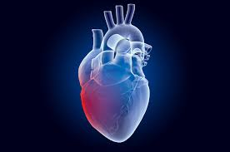
HEART DISEASE PREDCTION USING MACHINE LEARNING WITH PYTHON
By :- Eklavya gupta

Slide 2
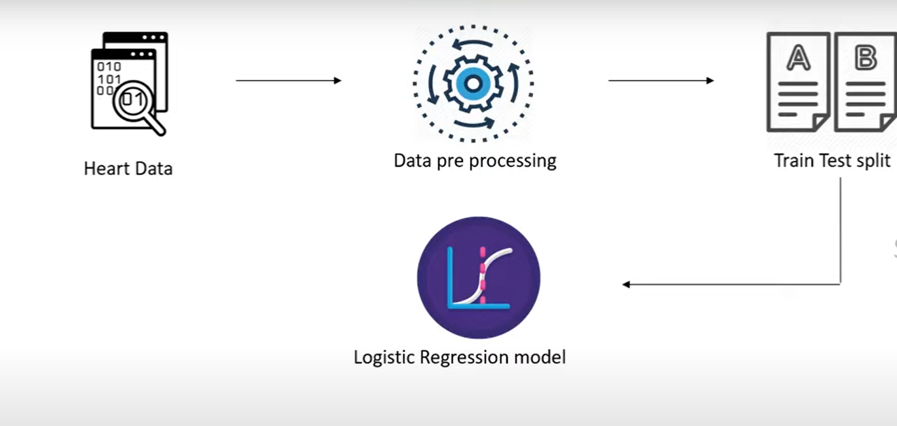
Work Flow
Work Flow

